Slide 1
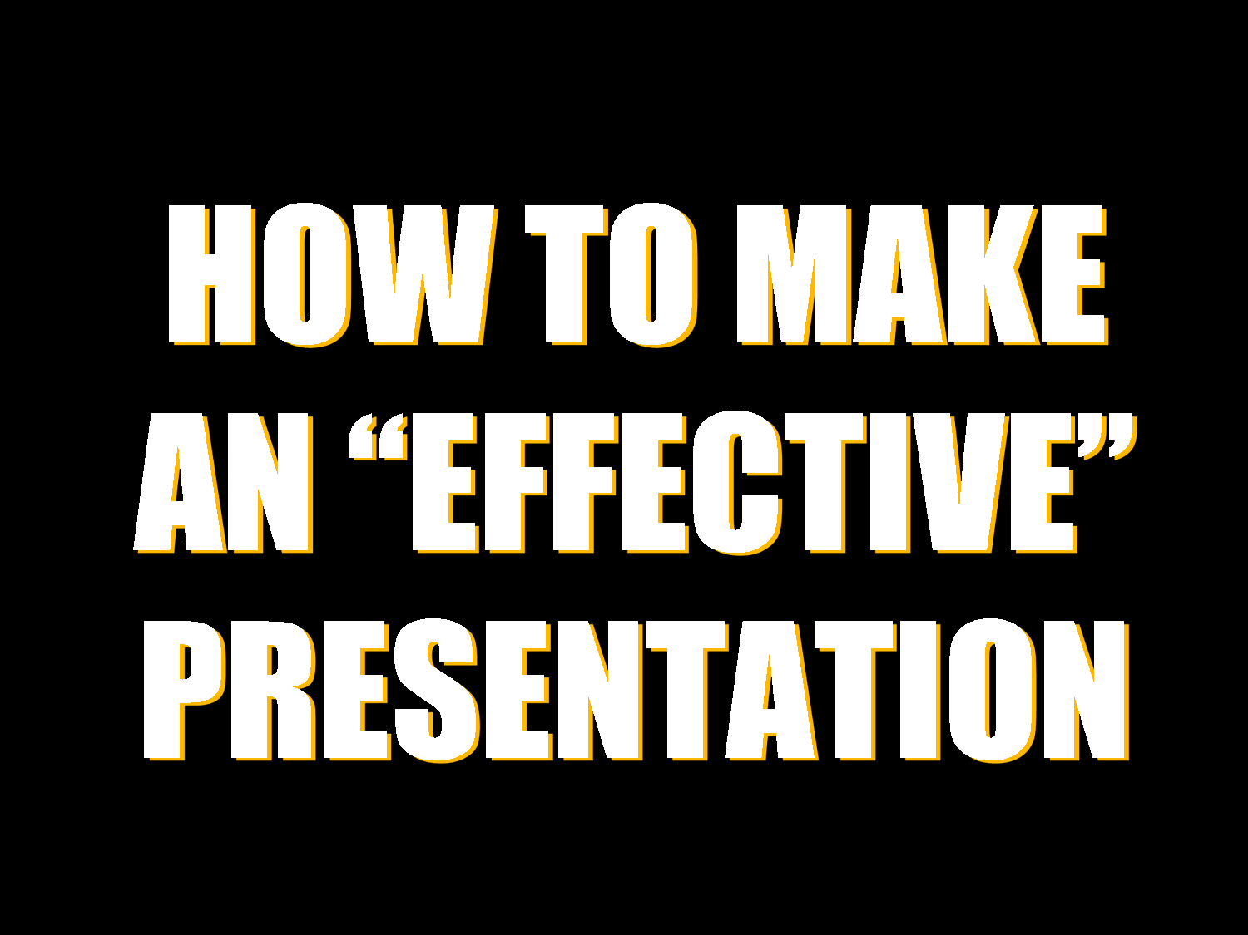
Lecture 6
How to make a presentation
1

Slide 2

Lecturer details
What is a presentation?
Why presentation is made?
What are the components of a presentation
How to make a presentation
2

Slide 3






What is presentation
Formal Introduction
Talking
Visual
Sound
Writing
3

Slide 4




Why presentation is made
Teach?
Make topic public
To convince
To consult
To inform
4

Slide 5
Components of a presentation
Presentation
Introduction
Body
Conclusion
5

Slide 6
1. Introduction
Introduce yourself
Your name
Position
Specialty
Welcome the audience
Capture your listeners’ attention
Say what your presentation will be about
Present an outline of your talk
6

Slide 7
2. Body
Present your main points one by one in logical order
Pause at the end of each point(Make sure the audience understood your point before you move to another point).
Make it absolutely clear when you move to another point
Use clear examples to illustrate your points
Use visual aids to make your presentation more interesting
7

Slide 8
3. Conclusion
Leave your audience with a clear summary ( Understanding your presentation)
Make it obvious that you have reached the
end of the presentation(do not leave any point without explain it).
Restate the purpose of your talk
Thank the audience
8

Slide 9
What to do: Before the presentation
Who are the audience?
What points do I want to get across?
How much time have I got?
What visual aids are available?
9

Slide 10
What to do: During the presentation
Talk to your audience, don't read to them!
Keep it simple
Emphasize the key points
Speak slowly and clearly
Keep within the allotted time
Eye contact, Smile, Voice change, Humour
Body language
10

Slide 11
End
Thank you
??????
11

